Slide 1
Search Engine Optimization
Understanding how to improve WeCloudData’s ranking on Google

Slide 2
SEO analysis
7 - Website inconsistencies
8 - Website updates
After:
We will take a look at collected Data on Streamlit Application
1 - Understanding the process
2 - Making Inventory of the pages
3 - Selecting the KPI’s
4 - Checking for Warnings
5 - Contents user wants
6 - Broken Links and impact on SEO

Slide 3
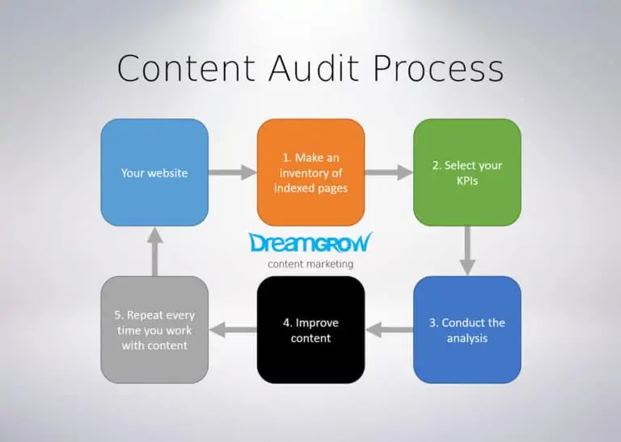
1 - Understanding the process
Source : https://www.dreamgrow.com/content-audit/

Slide 4
2 - Make inventory of search results
Web scraping based on specific keywords that points to the bootcamps available at WCD
Getting the top 20 result from Google and web scraping WCD and competitor’s
Keywords that were selected are :
Data Science Bootcamp
Data Engineering Diploma
Business Intelligence Bootcamp
DevOps Bootcamp

Slide 5
3 - Selecting the KPI’s
On-page SEO optimization - the process of optimizing contents of a page for both users and search engines.
Keyword density
Keywords in headings and subheadings
Instances of related keywords
Related keywords in headings and subheadings
Internal and external linking
The meta description
URL
Canonical URL
Page title
Image alt tags
Loading speed. Desktop vs Mobile
Source : https://terakeet.com/blog/seo-metrics/

Slide 6
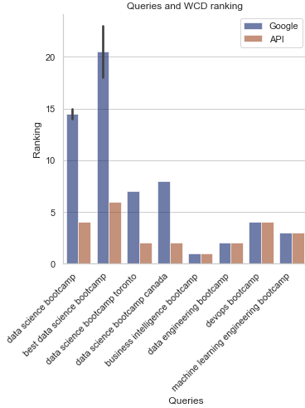
Query vs Rank Snapshot
*lower is better
*ranking within top ~8 = first page result
These are some of the queries we are ranking well organically and we should emphasize to increase our ranking.
Without prioritizing the SEO for this time we still rank quite well for DevOps, Data Engineering, Business Intelligence bootcamp
Worth noticing some discrepancies that appear on the Google API and Google’s ranking.
Some of the API’s ranking appears different than google research, even with same query and geographical location.
DS-related queries
Notes:
One figure for DS bootcamp, BI bootcamp, devOps bootcamp, data engineering bootcamp search result rank
One figure for a handful of DS queries (google browser result vs the API result)
Data science course / courses
Data science bootcamp
Data science bootcamp toronto
Data science bootcamp vancouver
Data science bootcamp online
Data science diploma

Slide 7


4 - Checking for warnings
Retrieved using PySeoAnalyzer library
What it needs to be fixed in all pages
Warns of any technical SEO issues
Meta description missing, description too long, too short, missing h - tags, alt - tags, image description, etc
Specifically into each of the pages we are deeply analyzing

Slide 8

5 - Content User Wants
Checking from “possible keywords” excel document, which keyword can be optimized in each of the Weclouddata pages that we are scrapping.
All those keywords are high volume keywords, so it would help drive more traffic to each page, we need to see which makes more sense to be linked to each page, or which ones already appear in the targeted selection from each page.

Slide 9
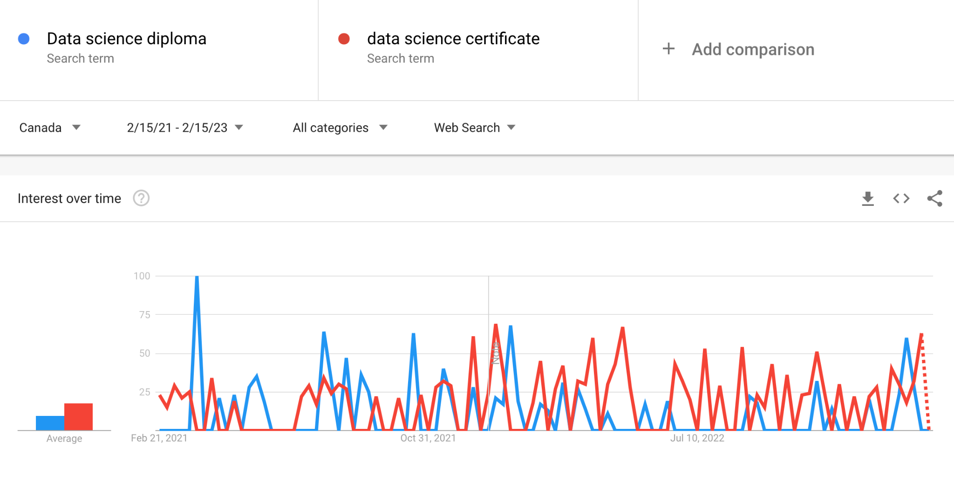
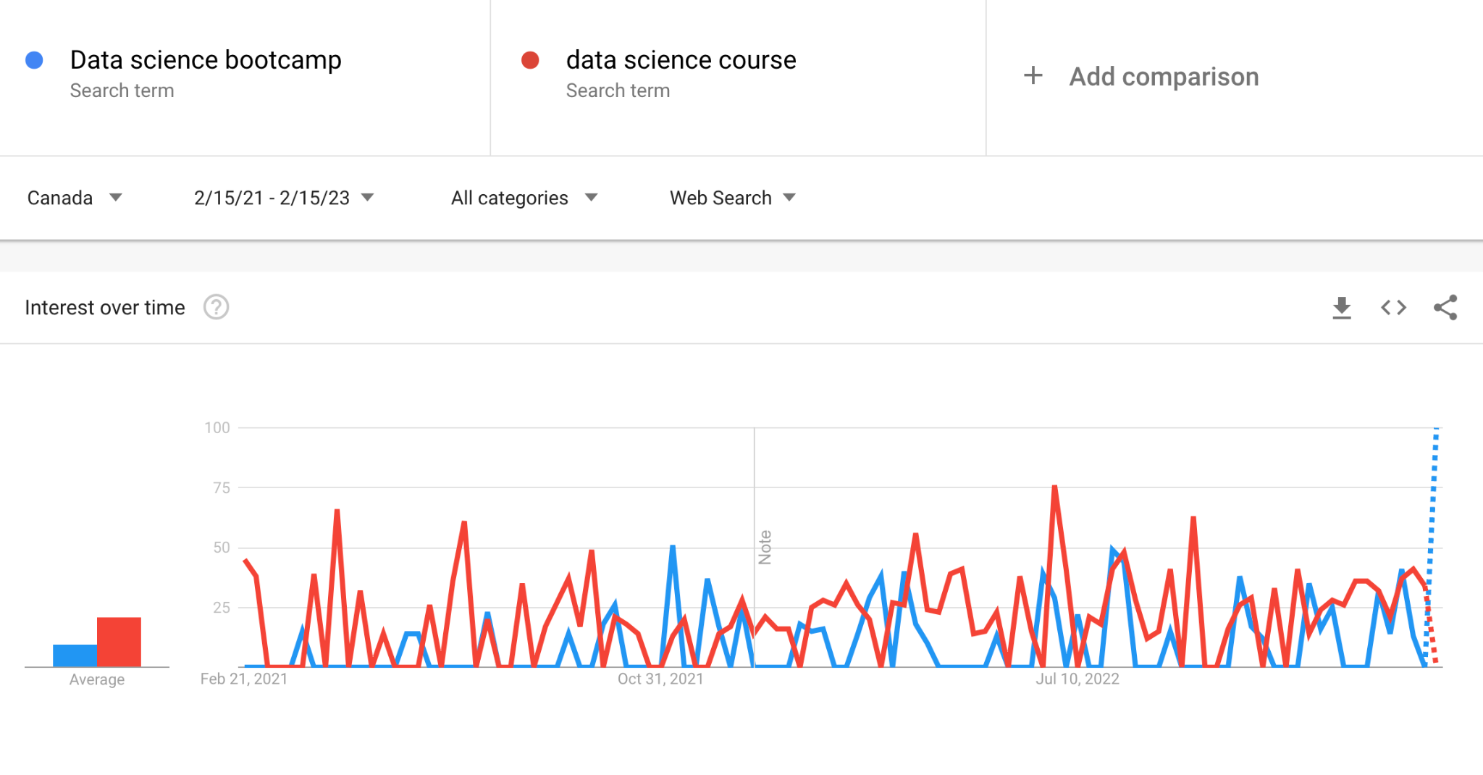
5 - Content User Wants
Retrieved from : https://trends.google.com/

Slide 10
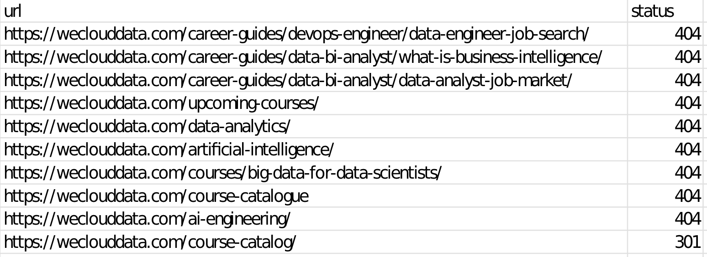
6 - Broken Links and impact on SEO
Broken links can destroy your conversion rates.
Broken links indirectly harm SEO by affecting bounce rate and time on site
Broken links may also directly harm SEO rankings by sending signals that your website is old and outdated
Notes:
See dashboard for more info

Slide 11
7 - Website URL Inconsistencies
Bootcamp vs Diploma vs Certificate are used interchangeably in program pages
Program names also vary
Student stories / student success -> testimonial
Non-categorized pages
20%+ of our web pages are non-categorized
How do we want to recategorize our categorized and non-categorized pages for better crawlability?
Numbered URL pages
https://weclouddata.com/11508/ -> https://weclouddata.com/blogs/Ernesto-Ramos-data-science
https://weclouddata.com/instructor/15163/,/15686/,/15720/ -> delete pages
Location vs online (Toronto vs Vancouver)
Data Science bootcamp - DS FT page rank 15 as of Feb 15th
Data Science bootcamp toronto - Home page appears on rank 5
Data Science bootcamp vancouver - Applied DS and Big Data Diploma page appears on rank 5
Notes:
DE - uses all 3 wordings
DS - applied DS and big data and DS bootcamp
BI - diploma and bootcamp
Overlap in keywords used across main pages results in home page showing up in google search results - see NEO4j results

Slide 12
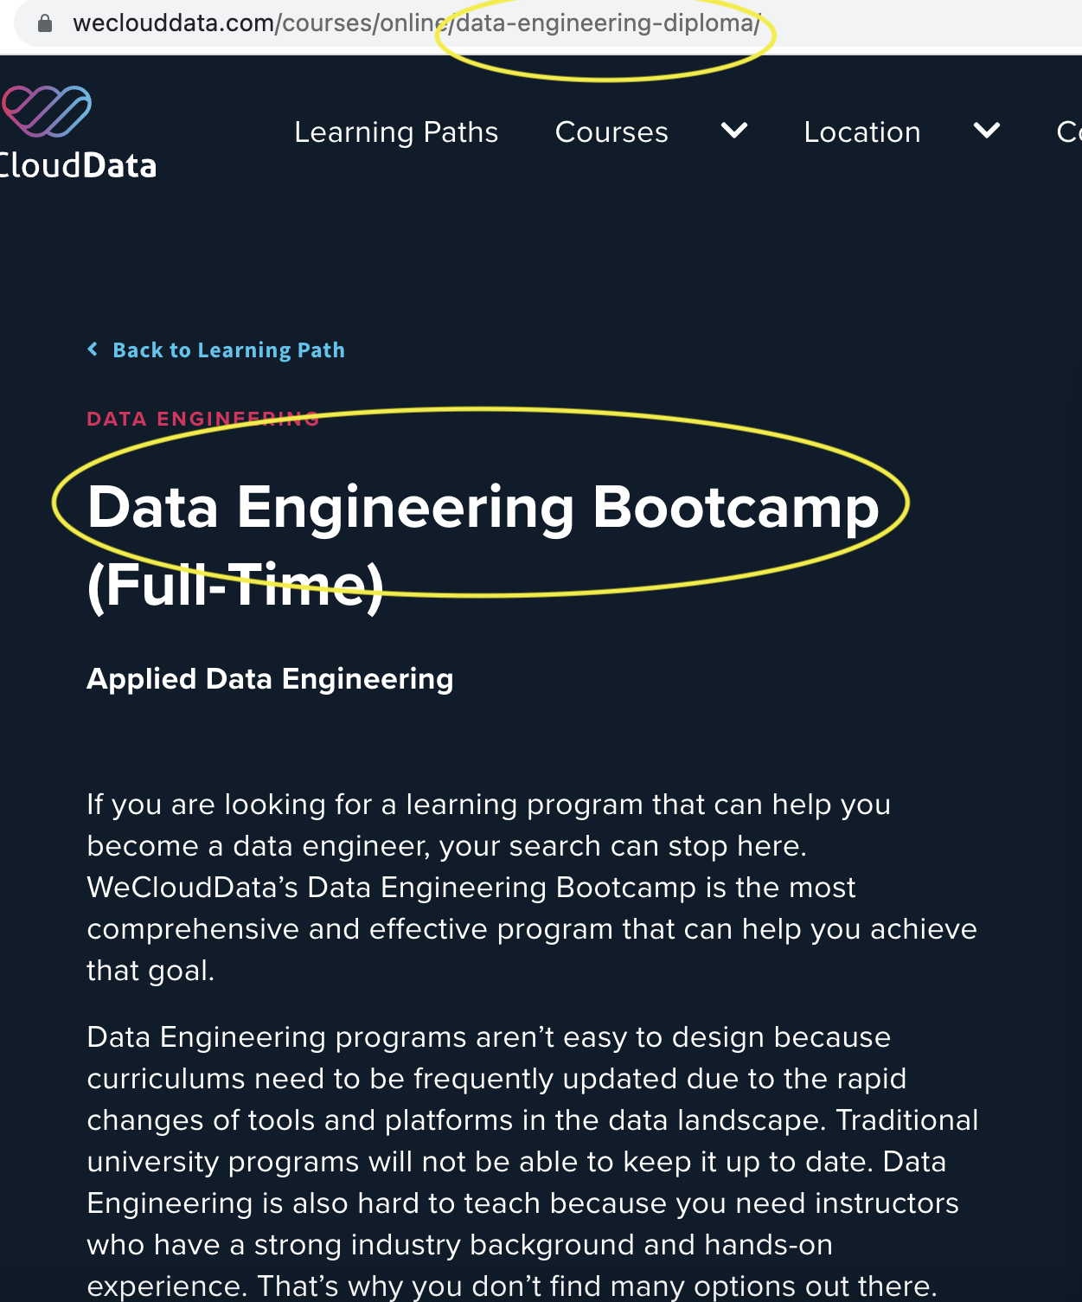
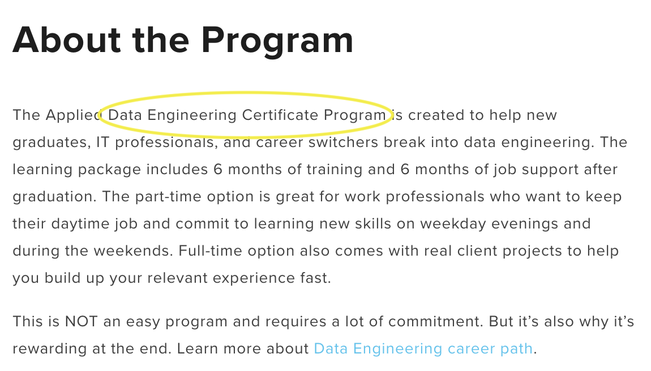
Website URL Inconsistencies
This shows the three being used almost interchangeably and not strengthening one query, or not being organized enough to rank on the three queries.
It can have more than one keyword in a page, but it needs to be better organized and focused
Domain, h tags, image description, etc.

Slide 13
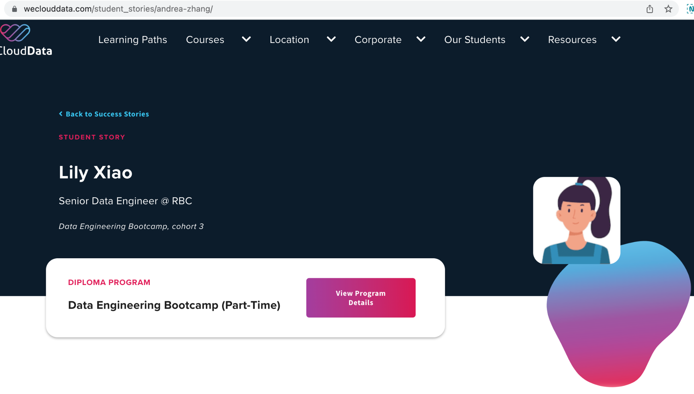
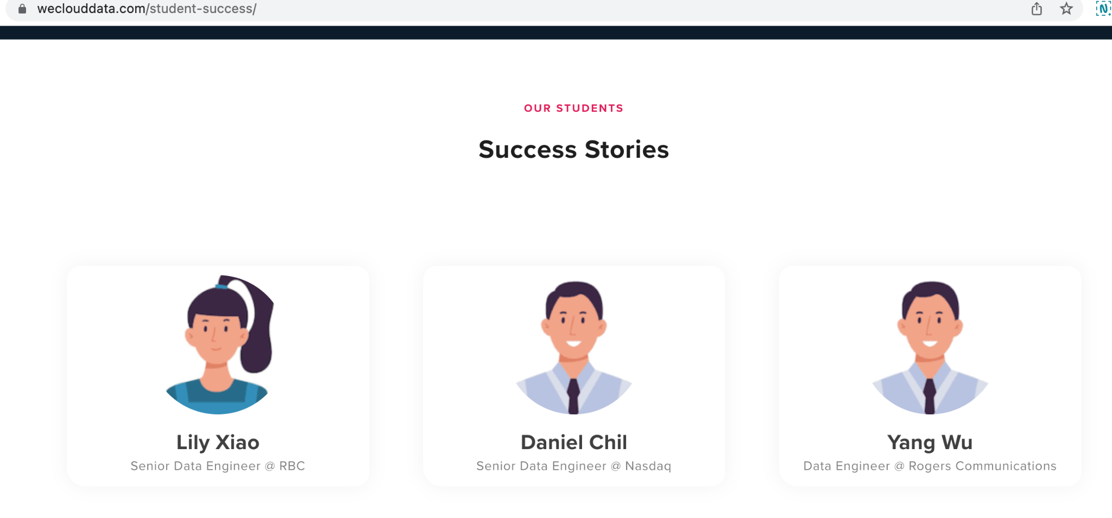
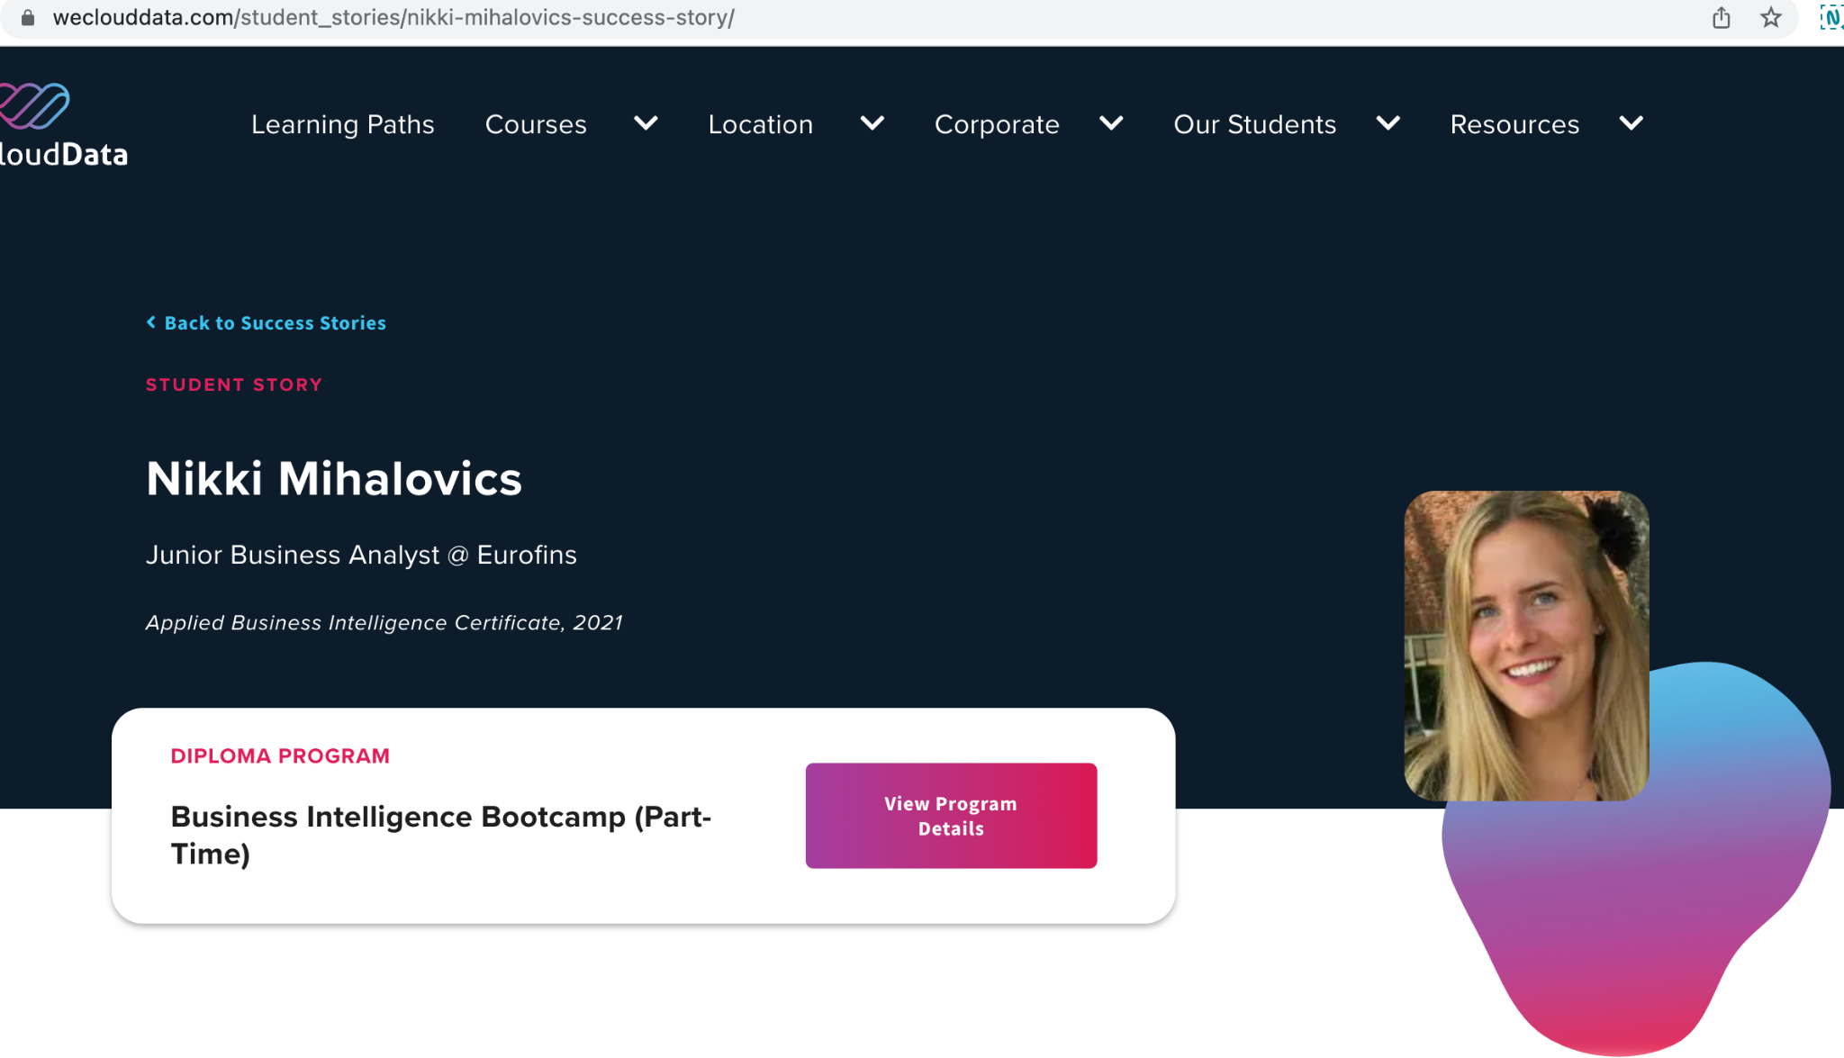
Website URL Inconsistencies
Url : https://weclouddata.com/student_stories/andrea-zhang/
Url :https://weclouddata.com/student-success/
Url : https://weclouddata.com/student_stories/nikki-mihalovics-success-story/

Slide 14
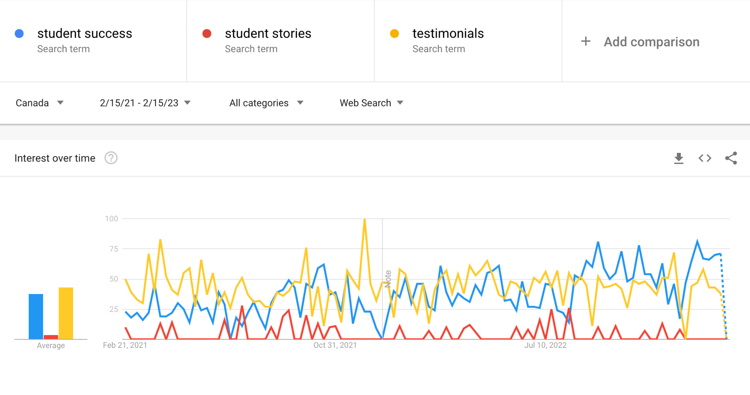
Google trends

Slide 15
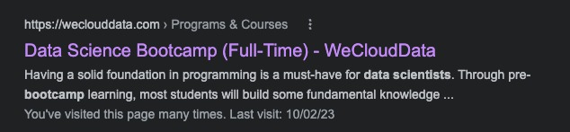
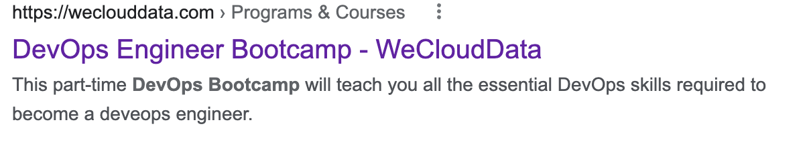
Google Search Result Snippet Comparison
Snippet of result is taken from SQL page as opposed to the meta description -> Can we change this?
May need to recrawl DS FT page
Update meta description
Snippet found on page description. Imposes better SEO for google, and better understanding of page.

Slide 16
8 - Website updates
https://web.archive.org/
Availability: Medium | Accuracy: Medium | Reliability: High
It contains free collections of digitized materials, such as websites, music, and books.
WayBack Machine is a free service by the Internet Archive which regularly visits and saves webpages over time. It provides a historical log of how the webpage looked the time it was visited by this machine. It also grants access to the webpage history even if the website went offline.

Slide 17

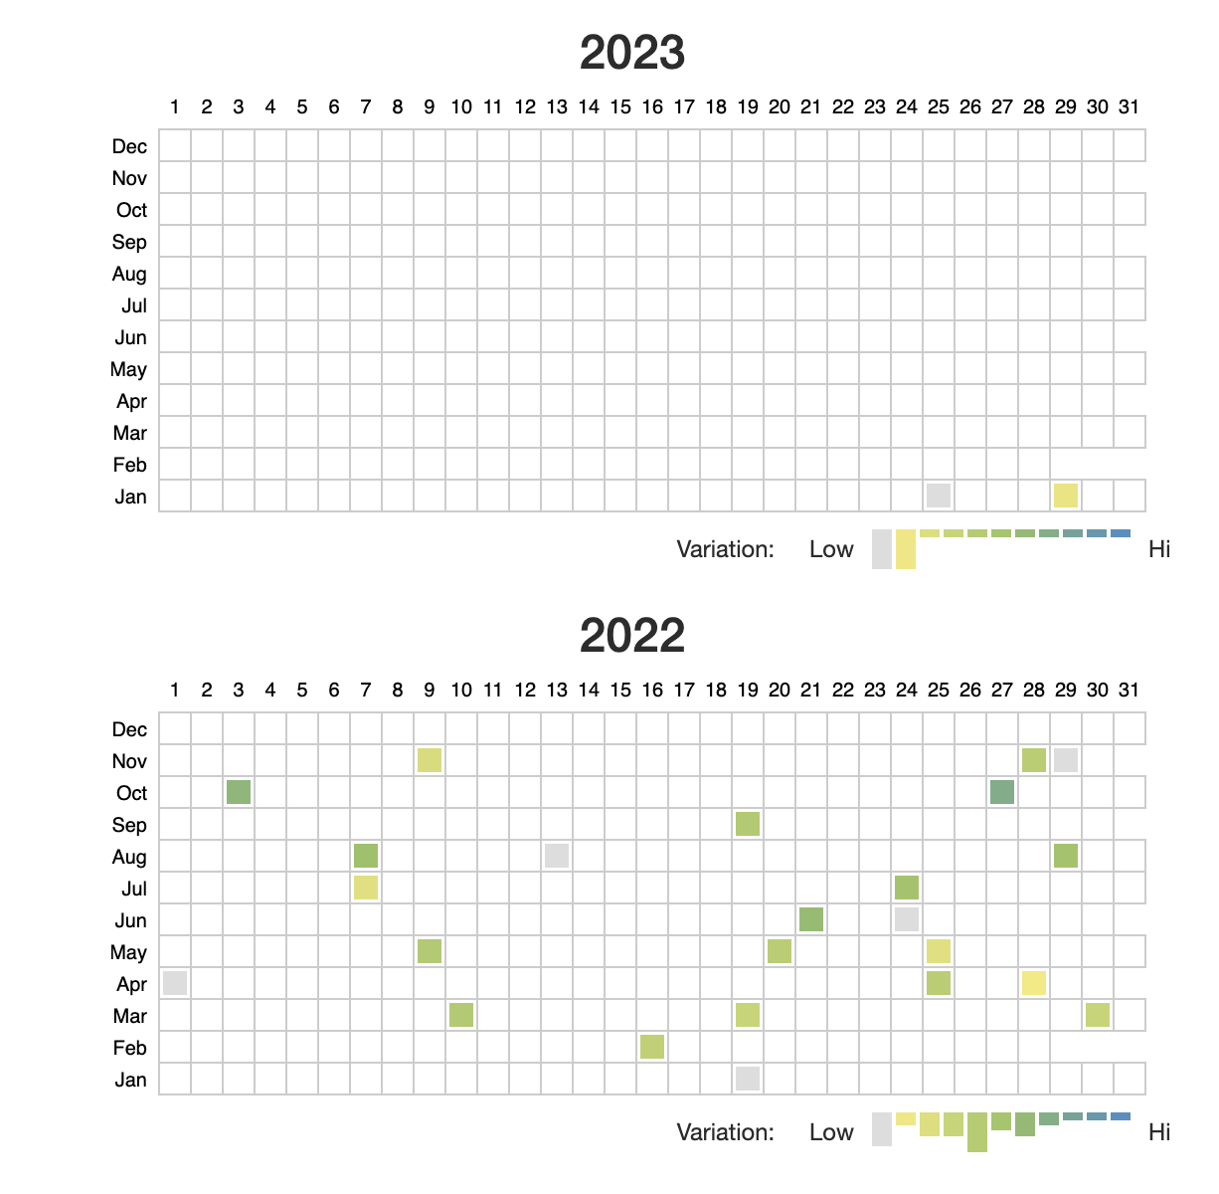
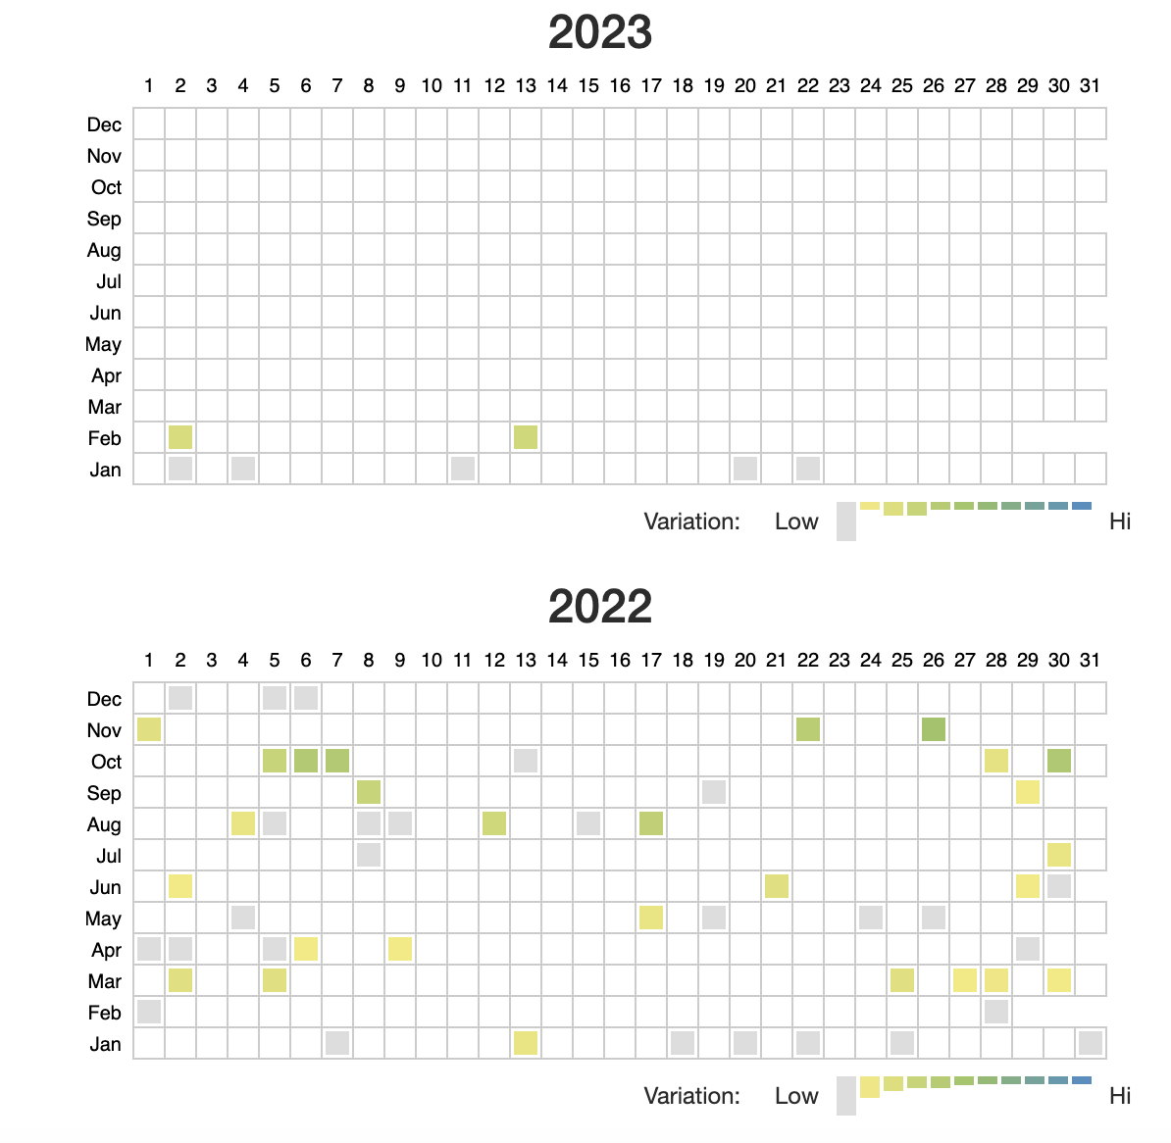
Website - New posts
LightHouseLabs
WCD
2023 - WCD 2 vs 7 LHL
2022 - WCD 24 vs 54 LHL

Slide 18
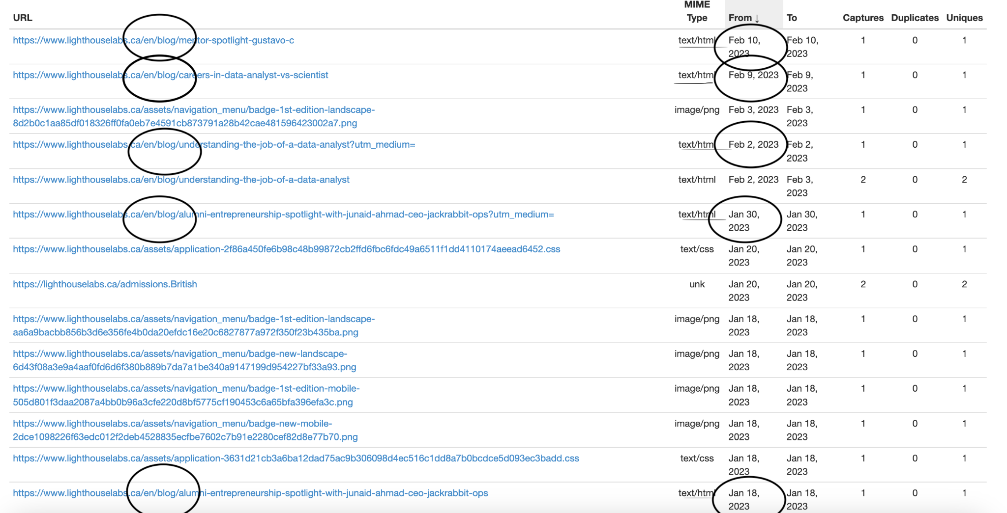
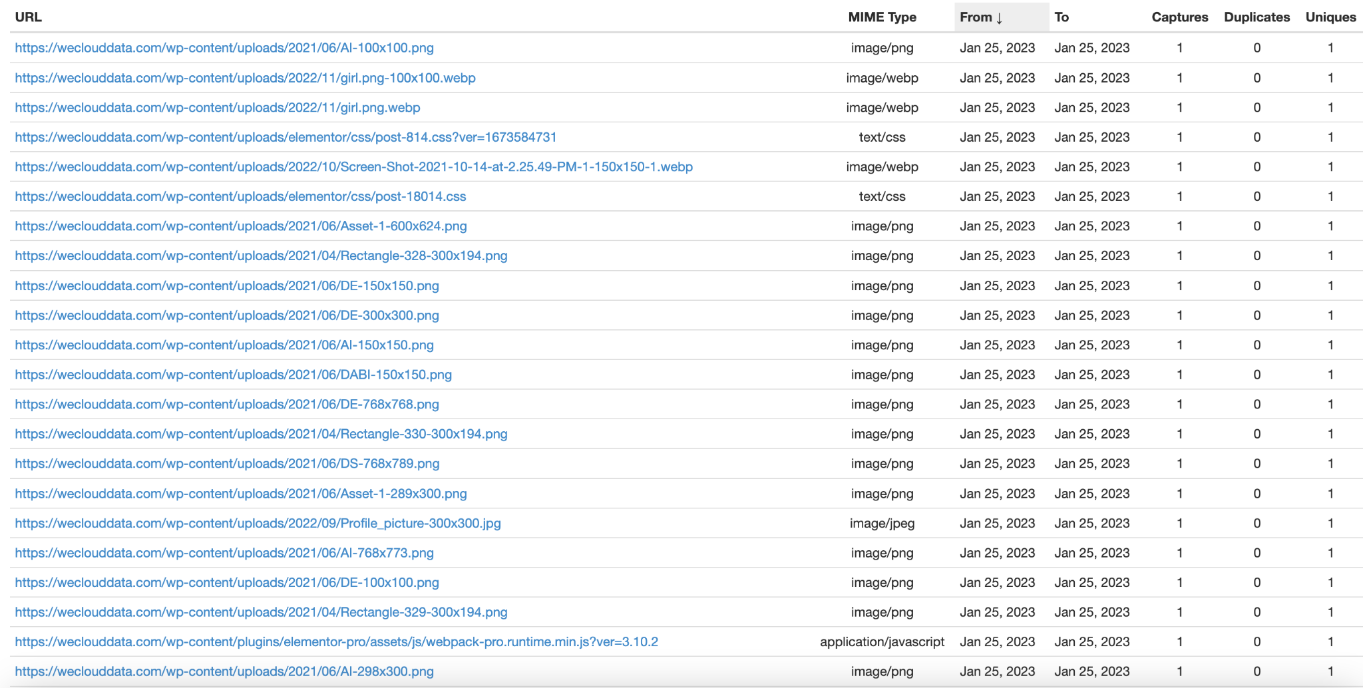
Website - New posts
As we saw on the previous slide, it shows a higher frequency of site update on LightHouseLabs
A good portion of those updates are new blog posts or revisions of the posts.
We can see a good portion of the changes at WeCloudData appear to be made in “batches”
More structural changes. And images, no new content being posted

Slide 19
What do we need to figure out ?
What are the competitors for each of the bootcamps and courses available for WeCloudData ?
How do we compare to each of them in all the necessary fields ?
Do we have any warnings or errors in each of those pages that we need to fix ?
How are we separating keywords on each page ?

Slide 20
Recommendations:
Data Science
Short, medium and Long term

Slide 21
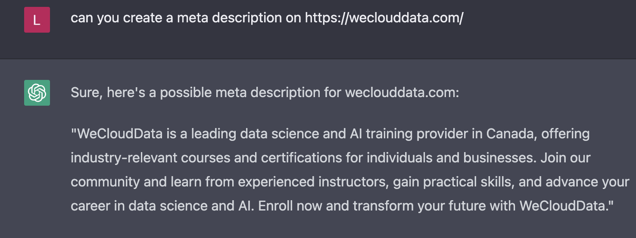
1 - Short Term
Do we want to optimize for ‘data science bootcamp’ or add in another set of keywords?
Address warnings from pySEOanalyzer, since the majority of them are quick fixes with formatting and adding tags (see dashboard)
Optimize meta description/ web page description using ChatGPT
Notes:
https://www.linkedin.com/posts/ai-evolution_chatgpt-has-changed-seo-forever-activity-7027796512382361600-ZLT2/?utm_source=share&utm_medium=member_desktop
WCD and udemy are the only ones that have missing description or description too short

Slide 22
1 - Short Term
Do we want to optimize for ‘data science bootcamp’ or add in another set of keywords?
Address warnings from pySEOanalyzer, since the majority of them are quick fixes with formatting and adding tags (see dashboard)
Optimize meta description/ web page description using ChatGPT
Format high traffic pages for better h-tags optimization
Emphasis on H1-H3 (i.e. Home page has no H1 & H2 tags)
Adding meta description/ page description to more pages
WCD ~ 25% vs LHL ~35%
Google recrawl website following updates
Home Page Title Change
Home page name on google show as “Home” so poor description
Notes:
https://www.linkedin.com/posts/ai-evolution_chatgpt-has-changed-seo-forever-activity-7027796512382361600-ZLT2/?utm_source=share&utm_medium=member_desktop

Slide 23
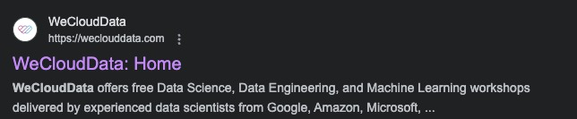
Short Term
“The leading data and AI training academy”
“The most effective Data & AI programs for career transformation”
"Launch Your Data Career: Join Our Bootcamp Today!"
"Transform Your Career with Our Data Bootcamps"
"Accelerate Your Learning with Our Data Bootcamp"
"Data Bootcamps: Your Gateway to a Career in Tech"
"Start Your Data Journey Today: Join Our Bootcamp"
"Join the Next Generation of Data Professionals: Our Bootcamp Awaits"

Slide 24
Short- Term
Dealing with broken links
use Google Webmaster Tools to check broken links. Under the “Crawl Errors,” you will be able to find broken links on your website.
Another option is to set up a custom filter on your Google Analytics account for your 404 Error page so you can track how many hits it gets.

Slide 25
2 - Medium Term
Be careful of cannibalization between pages
Eg. Different pages (data science bootcamp full-time and data science bootcamp part time, data science bootcamp and main page appear on Google’s query)
https://weclouddata.com/courses/online/data-science-bootcamp/
https://weclouddata.com/courses/online/data-science-bootcamp-part-time/
Have a 83% matched content (according to https://www.prepostseo.com/plagiarism-comparison-search )
Also be careful with multiple pages ranking and ‘fighting’ each other for better google rank, better to focus 1 in being higher than one in 7th and another in 9th.
Suggestion: One DS bootcamp page with a table showcasing differences between FT and PT offerings

Slide 26
3 - Long Term
Adding other keywords to generate more traffic with different searches
Excel files shows keywords that generates significant volume
Adapting the body text to include the keywords more organically
Creating more connection with different websites that can refer the link
Increases Backlinks -> cold calling websites
Increases Domain Authority
Leveraging student projects
Showcase student created projects
Content to attract more students & potentially increase conversion
Blog post can be utilized by students in future interviews

Slide 27
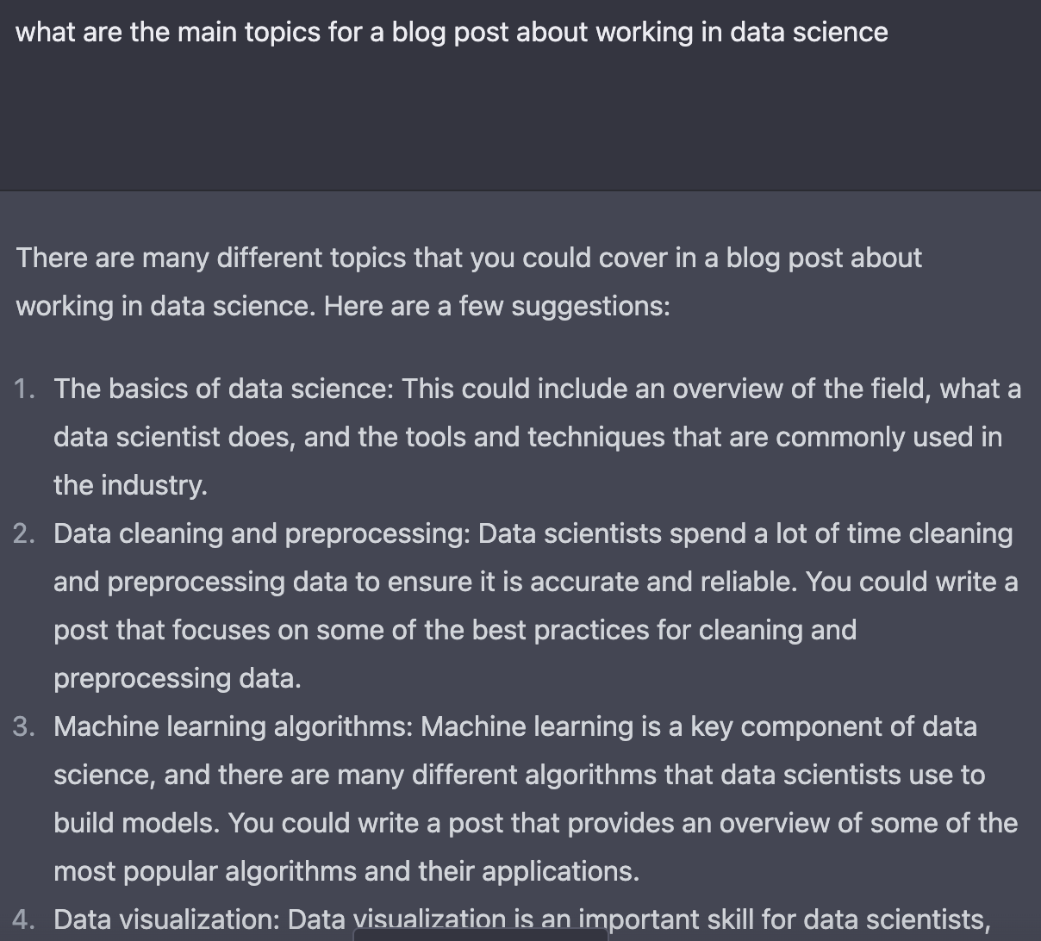
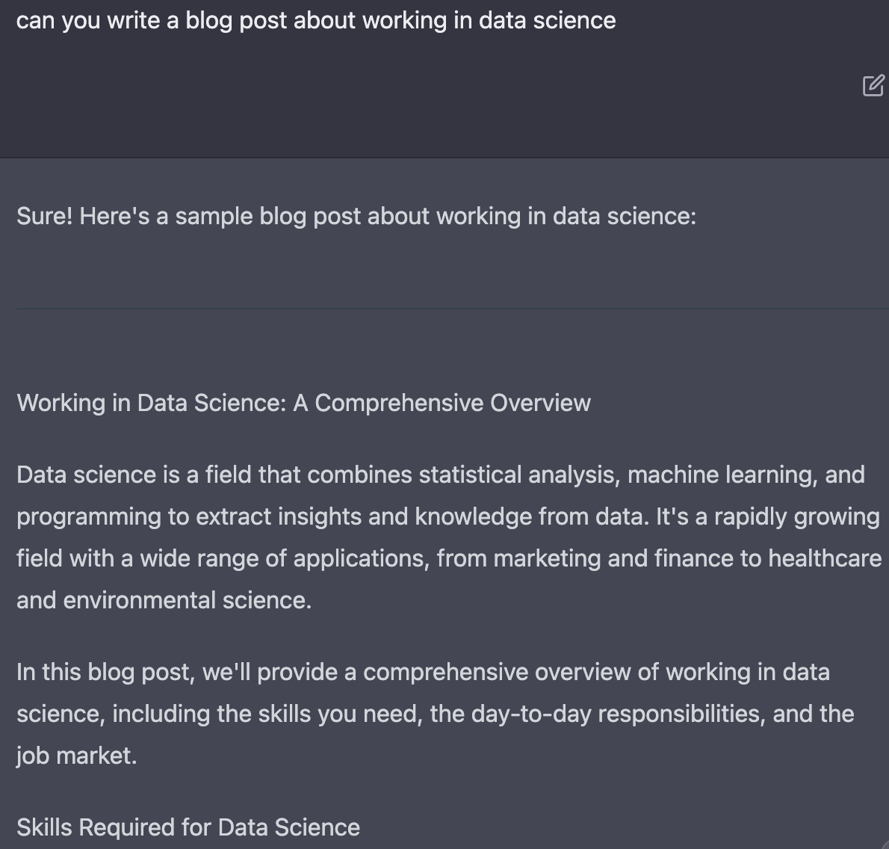
Long - Term
Blog post
Increase Frequency
Eg. : https://generalassemb.ly/blog/skills-tools-data-scientist-master/
Leverage ChatGPT to help speed the process (i.e. create a skeleton of your blog)

Slide 28
Recommendations: Other WCD Programs
ML engineering bootcamp
I.e. url uses “ml” -> change to “machine-learning”
Machine learning bootcamp keyword not found in meta description, H-tags, title, snippet, etc
DevOps bootcamp
Keyword is only in url, meta description

Slide 29
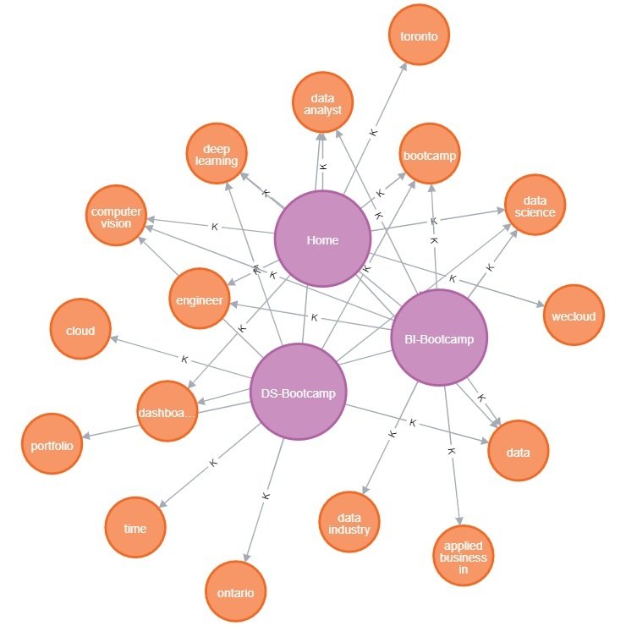
Notes:
Home: https://weclouddata.com/
DS((Data Science)-Bootcamp: https://weclouddata.com/courses/online/data-science-bootcamp/
BI(Business Intelligence )-Bootcamp: https://weclouddata.com/courses/online/business-intelligence-bootcamp/

